Slide 1
Super Mesh Section 3.5
Md. Shafqat Talukder Rakin
Lecturer, Department of CSE,
United International University
Email id : shafqat@cse.uiu.ac.bd

Slide 2
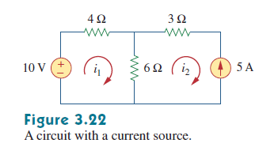
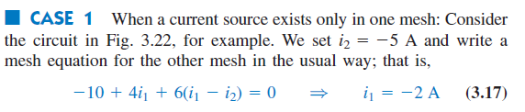
Mesh Analysis with Current Sources

Slide 3
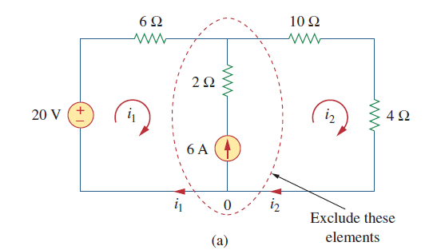
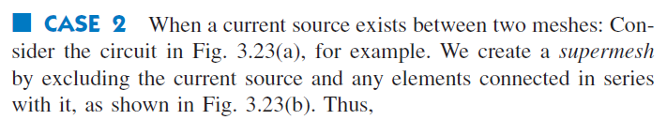

Mesh Analysis with Current Sources (Continued)

Slide 4
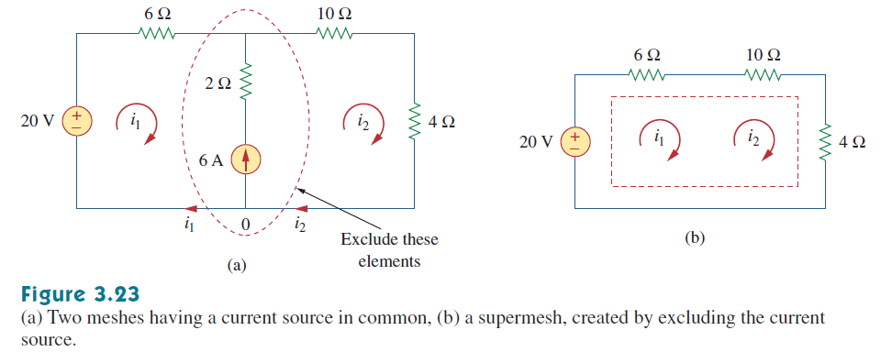
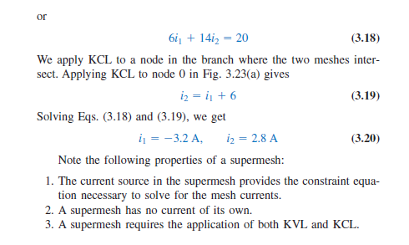
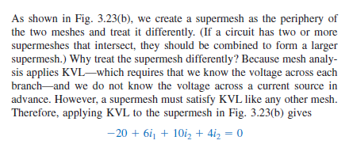
Mesh Analysis with Current Sources (Continued)

Slide 5
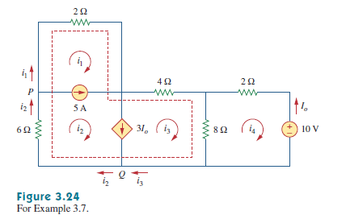
Math Problem Practice:
For the circuit in Fig. 3.24, find i1 to i4 using mesh analysis.
Reference: Sadiku_Example_3.7

Slide 6
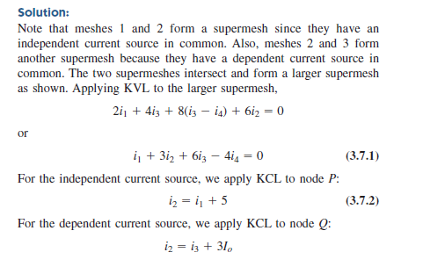
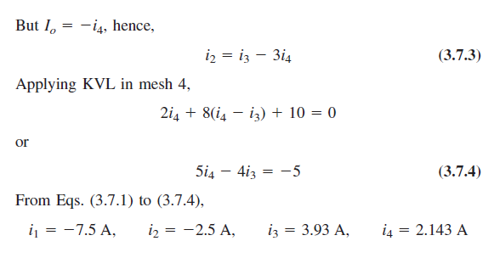
Math Problem Practice:
Reference: Sadiku_Example_3.7

Slide 7
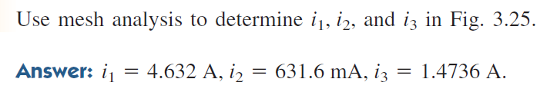
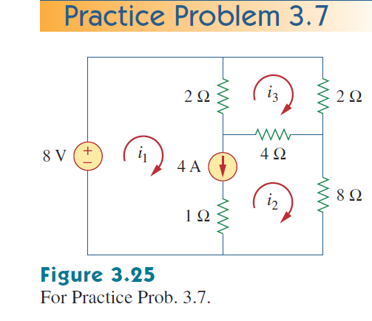
Math Problem Practice:
Reference: Sadiku_Practice_Problem_3.7

Slide 8
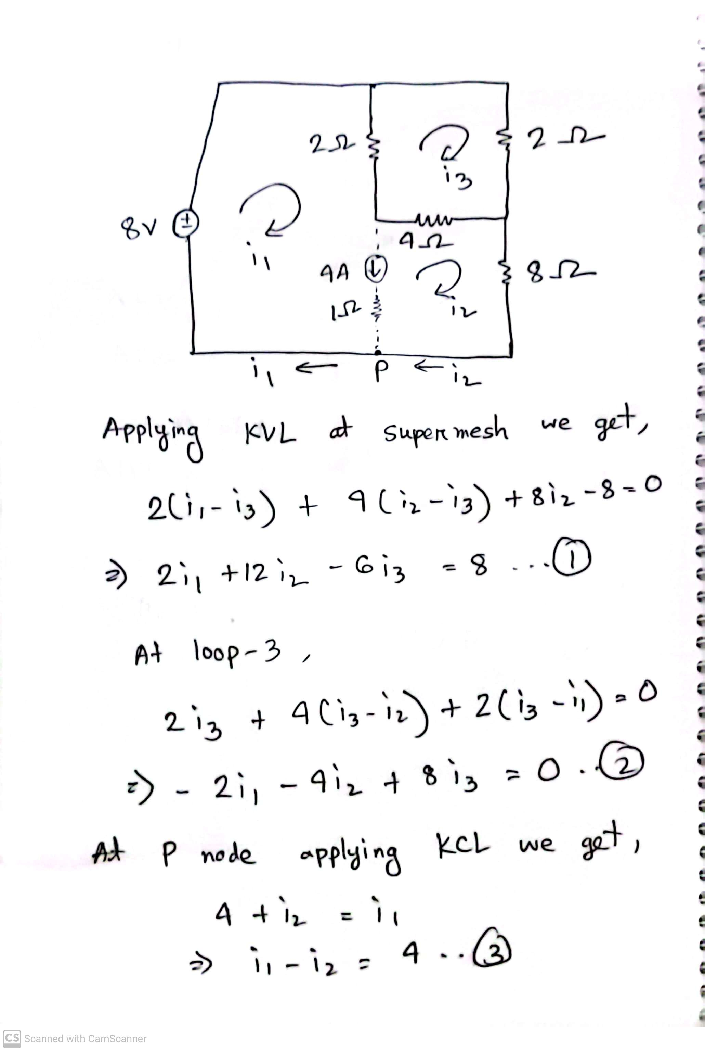
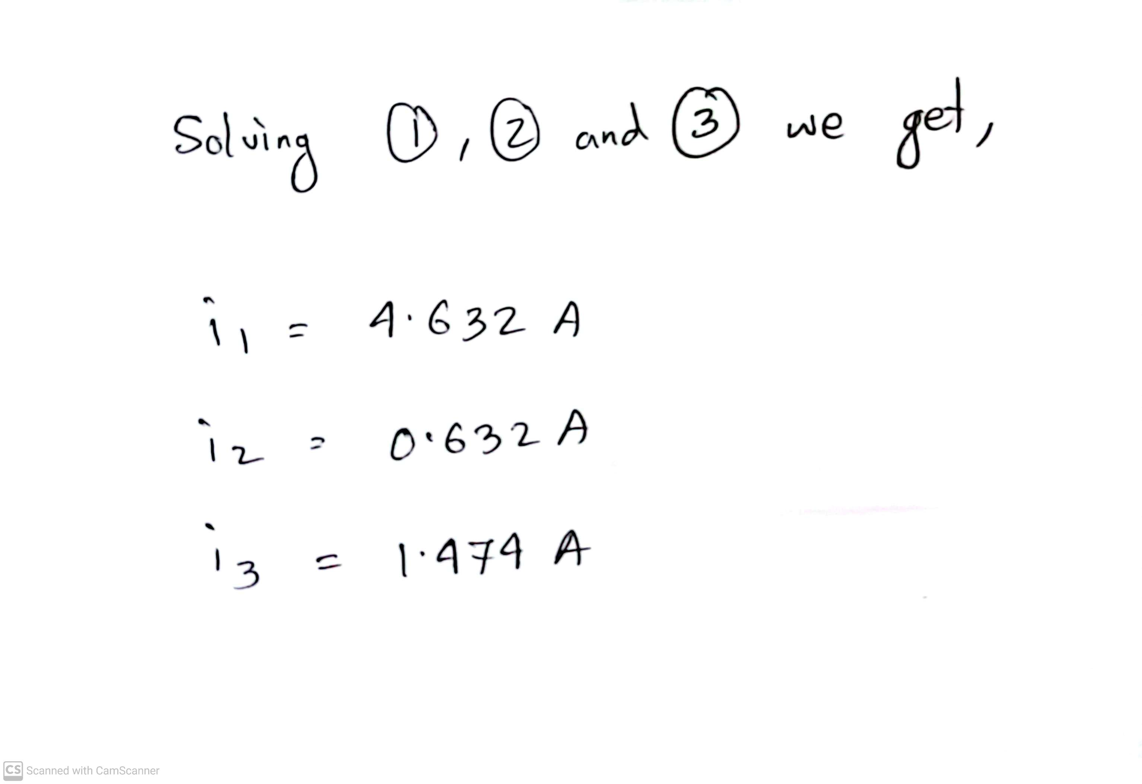
Math Problem Practice:
Reference: Sadiku_Practice_Problem_3.7

Slide 9
Math to Practice from the Book for Exam
Chapter 3
Example:
3.1, 3.2, 3.5, 3.6, 3.7
Practice Problem:
3.1, 3.2, 3.5, 3.6, 3.7
Problem:
3.2 to 3.9, 3.12, 3.14, 3.19, 3.38, 3.40, 3.41, 3.42, 3.43, 3.44, 3.45, 3.46, 3.48, 3.50, 3.51, 3.52, 3.55, 3.58, 3.63
N:B: Please note that the supernode concept is not in the present syllabus!

Slide 10
Thank You

